Slide 1
E6156 – Topics in SW Engineering: Cloud Computing
Lecture 6: Middleare, APIGW, Lambda, SSO, Events
© Donald F. Ferguson, 2021

Slide 2
Go To CourseWorks – Attendance Exam
X12983P

Slide 3

Contents
3 | E6156 – Topics in SW Engineering: Lecture 6: Middleware, APIGW, Lambda, SSO, Events © Donald F. Ferguson, 2021

Slide 4
Agenda
Stateless, and sessions.
Reprising “stateless”
Session and other examples
Middleware
Concepts: APIs, handlers
Three examples: security, notification, logging
Event Driven Processing
Concepts and motivation
Applied to your projects: email verification, webhooks
Function-as-a-Service, AWS Lambda functions
HW2 – Sprint 2 Objectives

Slide 5
Stateless, Sessions Example
5 | E6156 – Topics in SW Engineering: Lecture 6: Middleware, APIGW, Lambda, SSO, Events © Donald F. Ferguson, 2021

Slide 6
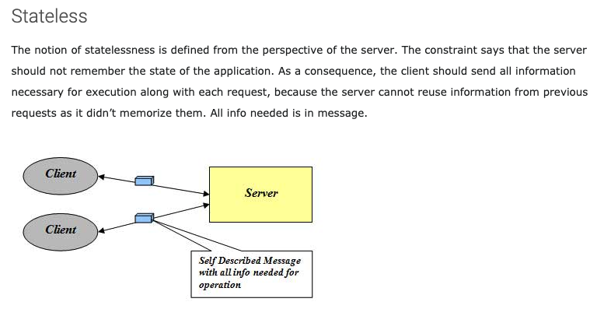
Stateless
http://mrbool.com/rest-architectural-elements-and-constraints/29339

Slide 7
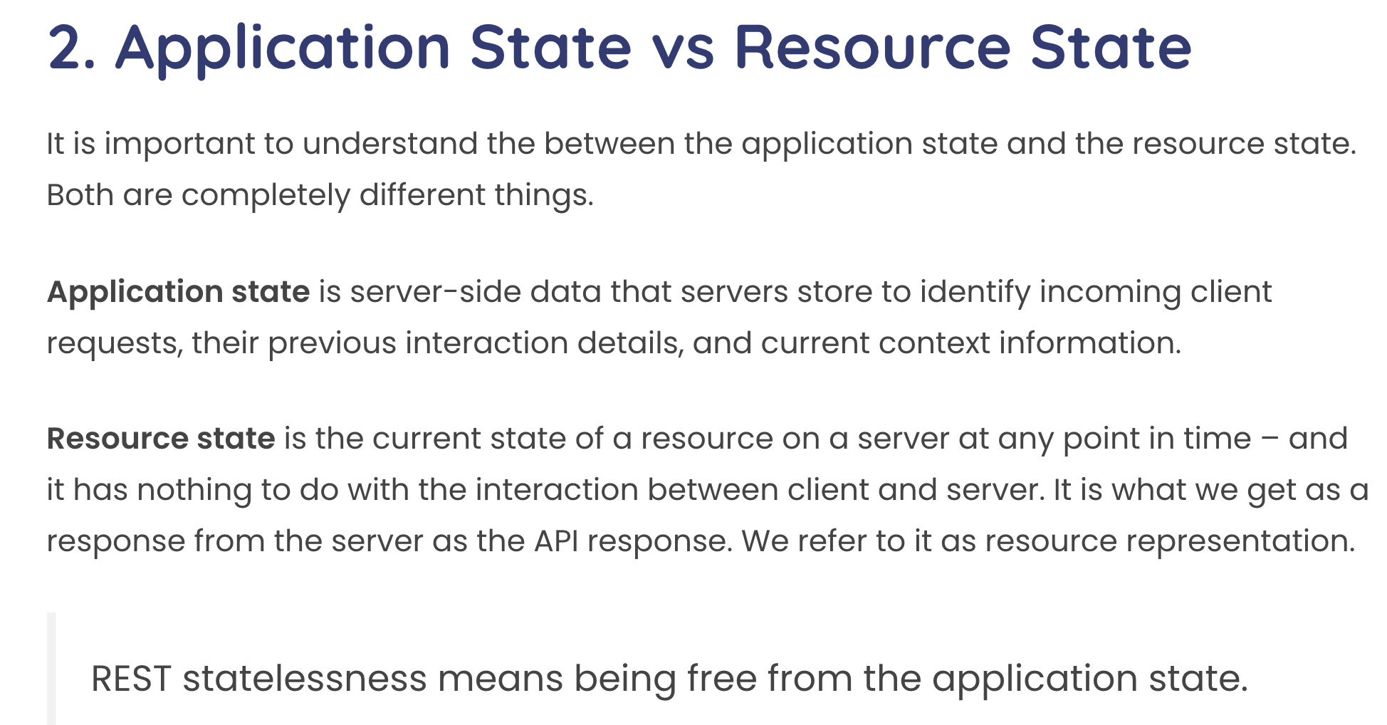
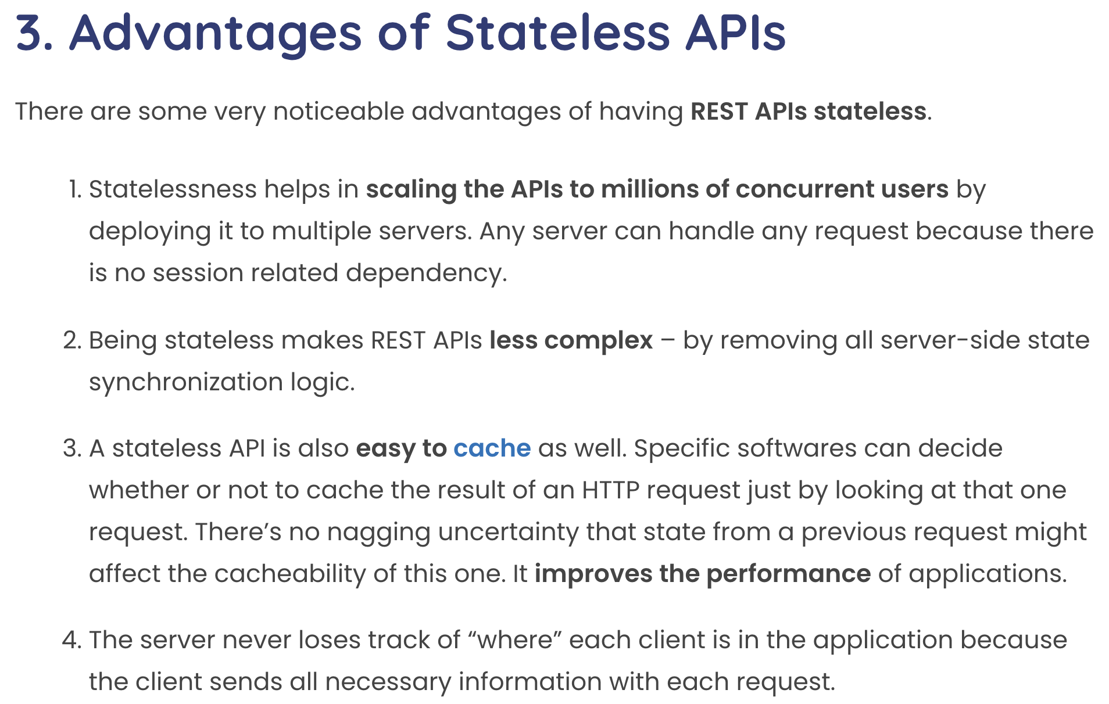
Statelessness
This concept can be confusing with experience with other approach to session state.
Some application frameworks did/do keep session state on the server.
Application servers and frameworks have various support for “session state,” e.g. https://flask-session.readthedocs.io/en/latest/

Slide 8
Simple Example from Databases
“In computer science, a database cursor is a mechanism that enables traversal over the records in a database. Cursors facilitate subsequent processing in conjunction with the traversal, such as retrieval, addition and removal of database records. The database cursor characteristic of traversal makes cursors akin to the programming language concept of iterator.” (https://en.wikipedia.org/wiki/Cursor_(databases))
Database Server
create_cursor()
fetch()
fetch()
close()
Cursor
... ...
... ...
Client Application
Cursor
Database Server
The client and database server share the “state of the cursor.”
This is separate from the state of the data.
This hinders scalability and fault tolerance if there are multiple database servers in a cluster.

Slide 9
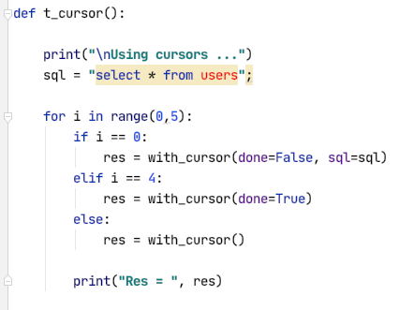
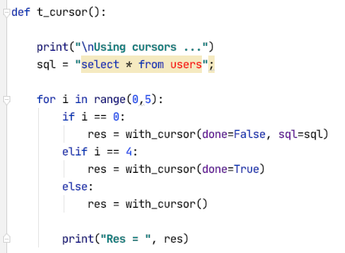
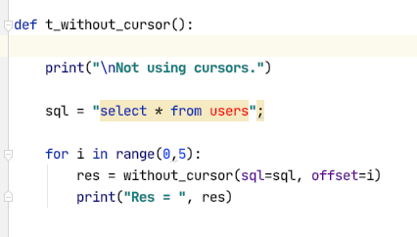
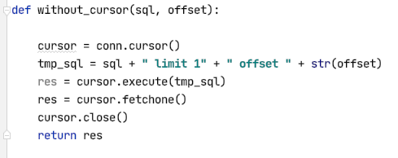
Some Code

Slide 10
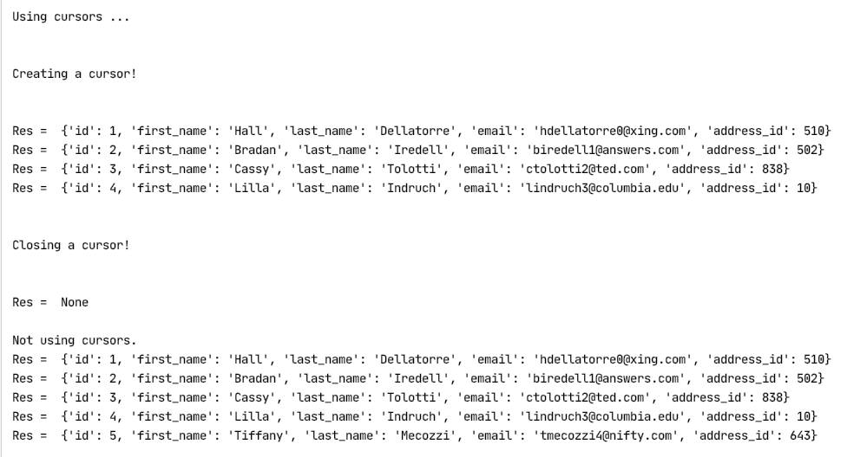
An Execution

Slide 11
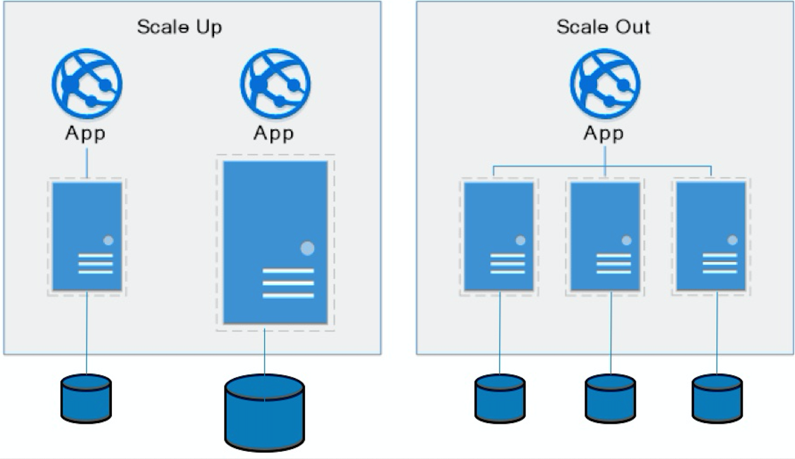
Approaches to Scalability
Scalability is the property of a system to handle a growing amount of work by adding resources to the system.
Replace system with a bigger machine, e.g. more memory, CPU, ... ...
Scale-up:
Less incremental.
More disruptive.
More expensive for extremely large systems.
Does not improve availability
Scale-out:
Incremental cost.
Data replication enables availability.
Does not work well for functions like JOIN, referential integrity, ... ...
Add another system.

Slide 12
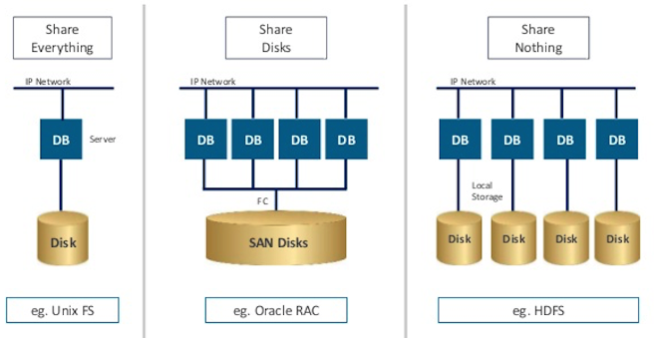
Disk Architecture for Scale-Out
Share disks:
Is basically scale-up for data/disks. You can use NAS, SAN and RAID.
Isolation/Integrity requires distributed locking to control access from multiple database servers.
Share nothing:
Is basically scale-out for disks.
Data is partitioned into shards based on a function f() applied to a key.
Can improve availability, at the code consistency, with data replication.
There is a router that sends requests to the proper shard based on the function.

Slide 13
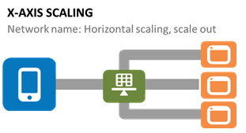
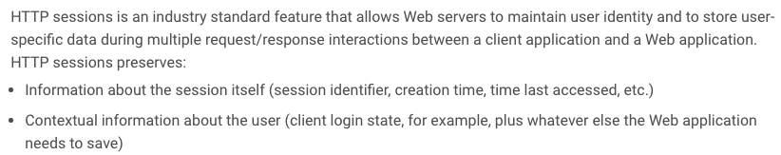
Stateless
There are similar design issue for microservice applications.
There is conversation state, e.g.
Did the client create a shopping cart?
Did the client choose a preferred store?
etc.
Prior technologies maintained the conversation on the server, e.g. HttpSession. (https://docs.progress.com/bundle/pas-for-openedge-administration-117/page/Overview-of-HTTP-sessions.html)
Stateless with respect to conversations has much better scalability and availability.
Show in demo (demo-flask). Mention Cookie is default but headers also work if the client application understand and uses the header. (Also, show header in Postman)
https://docs.progress.com/bundle/pas-for-openedge-administration-117/page/Overview-of-HTTP-sessions.html

Slide 14
Middleware
14 | E6156 – Topics in SW Engineering: Lecture 6: Middleware, APIGW, Lambda, SSO, Events © Donald F. Ferguson, 2021

Slide 15
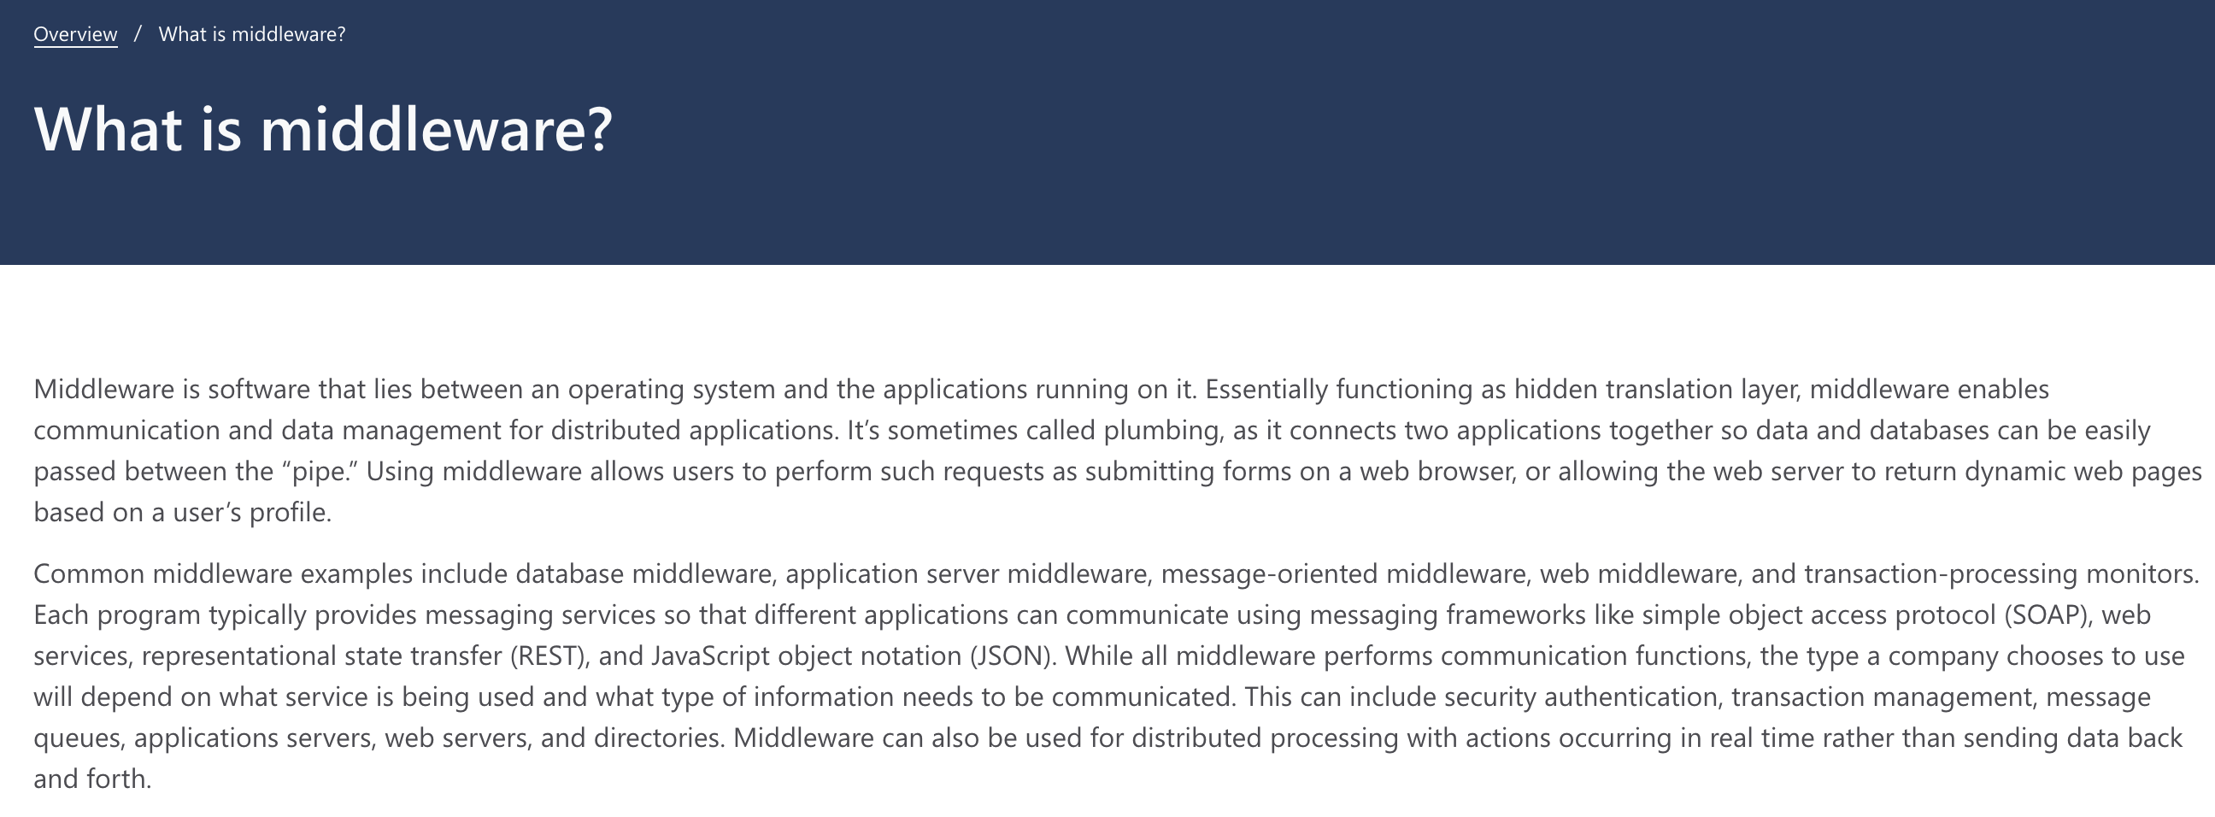
Middleware

Slide 16
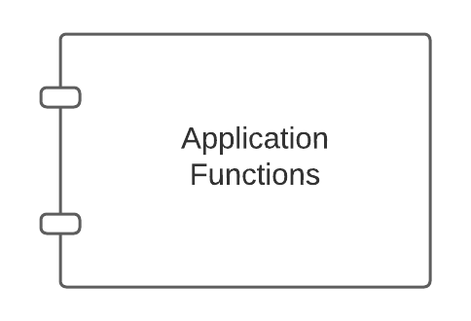
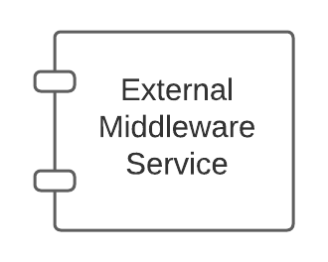
Middleware – Conceptual Model
Middleware:
Application might call directly, e.g. DB
May be implicitly called as part of request processing, e.g. logging.

Slide 17
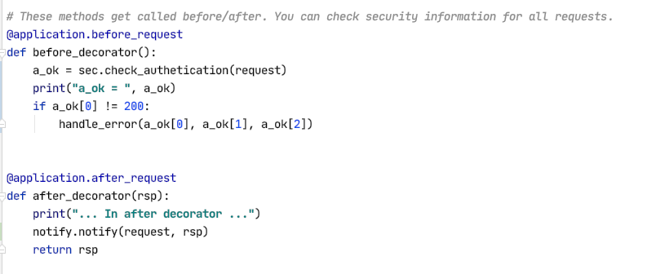
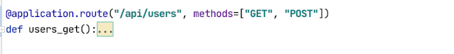
Middleware and Flask
White list of URLs
If not on white list:
Verify token
Verify authorization
List of filters of the form:
URL
HTTP Method
SNS topic to use
Send an event to SNS if matches filter
Show some demo code.

Slide 18
So, How Will We Use This?
Add before_request and after_request to microservices. (Note: There are other approaches).
Implement two middleware interceptors:
Security
Configured with a JSON file.
File lists which {path, method} not being logged on.
While IDs can perform which methods on which paths.
Automates driving login redirect (401 – Unauthorized)
Checks authorization (403– Forbidden)
Notification:
Configured with JSON in environment variables.
File lists which operations emit a before and/or after event to an SNS topic.
We will use notification to drive some other things like webhooks.
I will demo middleware and webhook today.
Your project will use middleware and SNS.

Slide 19
Event Drive Processing Publish/Subscribe
19 | E6156 – Topics in SW Engineering: Lecture 6: Middleware, APIGW, Lambda, SSO, Events © Donald F. Ferguson, 2021

Slide 20
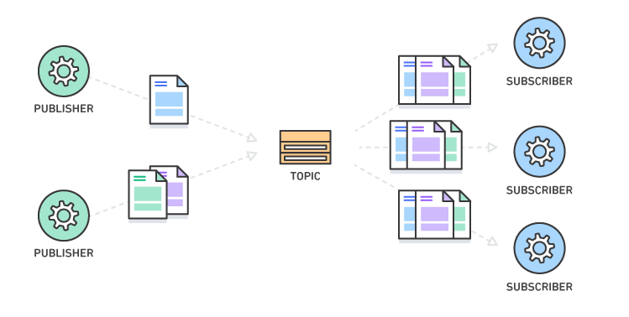
Pub/Sub – Event Driven Processing
“In software architecture, publish–subscribe is a messaging pattern where senders of messages, called publishers, do not program the messages to be sent directly to specific receivers, called subscribers, but instead categorize published messages into classes without knowledge of which subscribers, if any, there may be. Similarly, subscribers express interest in one or more classes and only receive messages that are of interest, without knowledge of which publishers, if any, there are.
Publish–subscribe is a sibling of the message queue paradigm, and is typically one part of a larger message-oriented middleware system. Most messaging systems support both the pub/sub and message queue models in their API, e.g. Java Message Service (JMS).
This pattern provides greater network scalability and a more dynamic network topology, with a resulting decreased flexibility to modify the publisher and the structure of the published data.”
For microservices:
It support loose coupling for application evolution and agility.
I can add and evolve services without modifying the the base services.
For example,
If creating a customer service calls “send an email.”
I have to modify the original code to add support for SMS, webhook, etc.
With EDA, I just add or modify subscriptions.
https://en.wikipedia.org/wiki/Publish%E2%80%93subscribe_pattern
20 | E6156 – Topics in SW Engineering: Lecture 6: Middleware, APIGW, Lambda, SSO, Events © Donald F. Ferguson, 2021

Slide 21
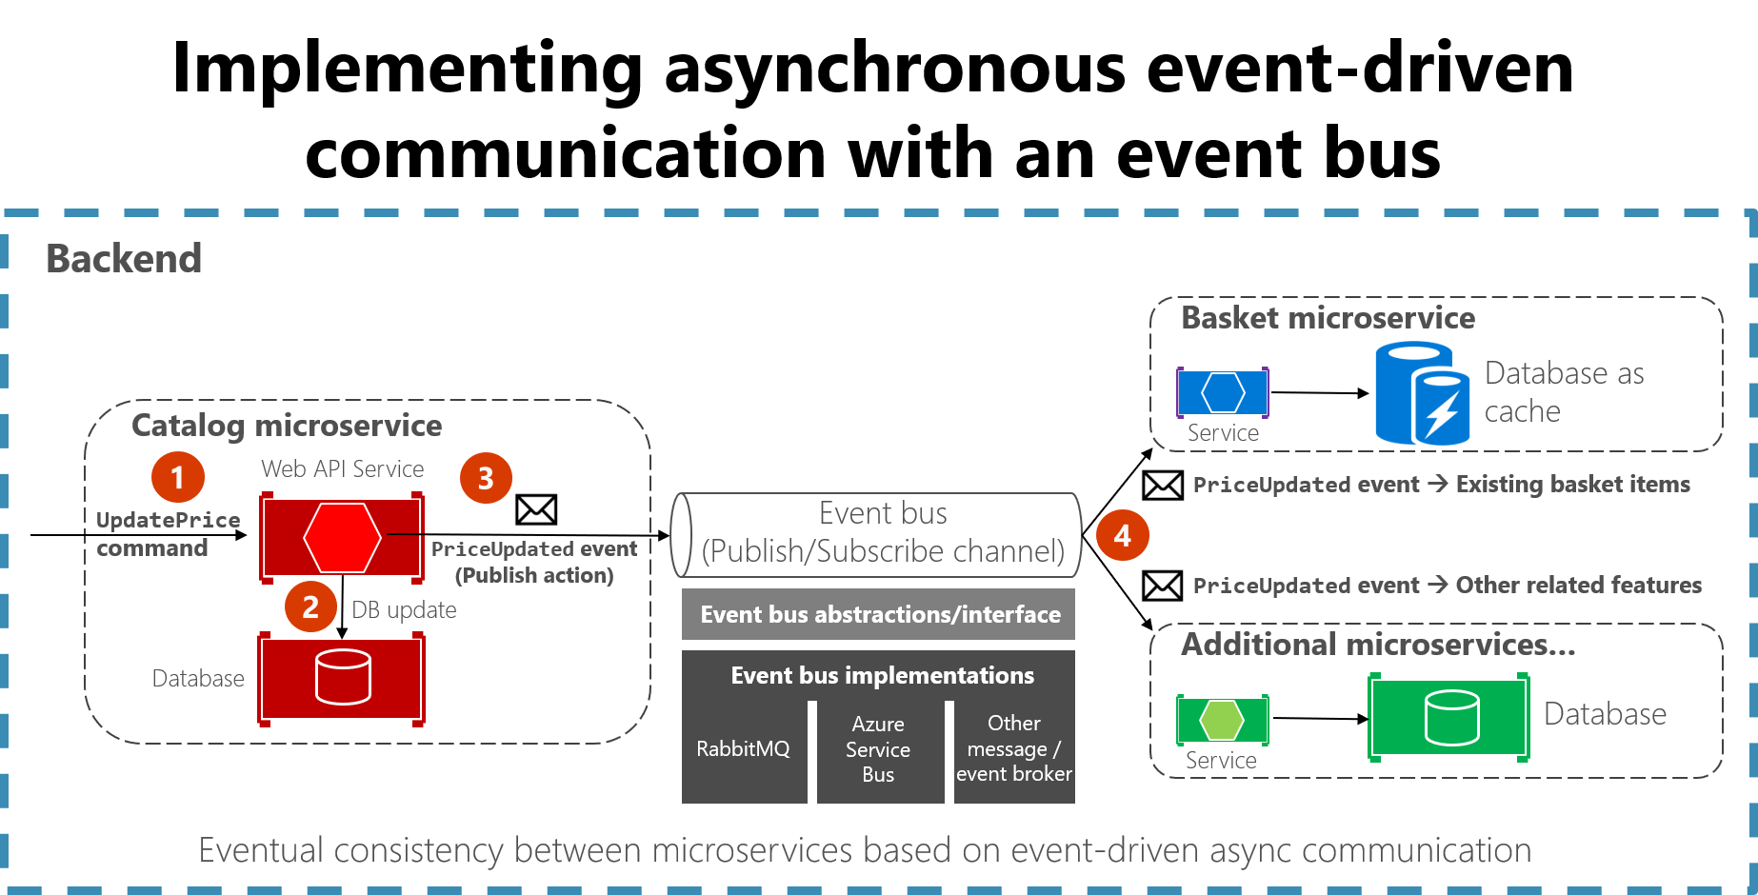
Concept
https://docs.microsoft.com/en-us/dotnet/architecture/microservices/multi-container-microservice-net-applications/integration-event-based-microservice-communications

Slide 23
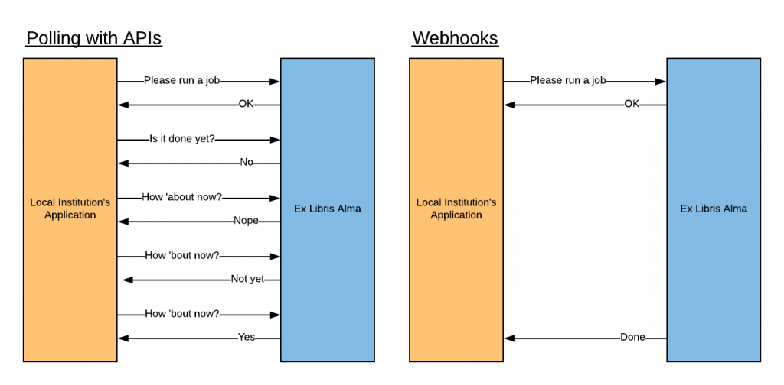
Webhooks
“A webhook in web development is a method of augmenting or altering the behavior of a web page or web application with custom callbacks. These callbacks may be maintained, modified, and managed by third-party users and developers who may not necessarily be affiliated with the originating website or application. The term "webhook" was coined by Jeff Lindsay in 2007 from the computer programming term hook.”

Slide 24
Function-as-a-Service
24 | E6156 – Topics in SW Engineering: Lecture 6: Middleware, APIGW, Lambda, SSO, Events © Donald F. Ferguson, 2021

Slide 25
Serverless and Function-as-a-Service
Serverless computing is a cloud computing execution model in which the cloud provider runs the server, and dynamically manages the allocation of machine resources. Pricing is based on the actual amount of resources consumed by an application, rather than on pre-purchased units of capacity.^{[1]} It can be a form of utility computing. Serverless computing can simplify the process of deploying code into production. Scaling, capacity planning and maintenance operations may be hidden from the developer or operator. Serverless code can be used in conjunction with code deployed in traditional styles, such as microservices. Alternatively, applications can be written to be purely serverless and use no provisioned servers at all.^{[2]} This should not be confused with computing or networking models that do not require an actual server to function, such as peer-to-peer (P2P).”
Function as a service (FaaS) is a category of cloud computing services that provides a platform allowing customers to develop, run, and manage application functionalities without the complexity of building and maintaining the infrastructure typically associated with developing and launching an app.^{[1]} Building an application following this model is one way of achieving a "serverless" architecture, and is typically used when building microservices applications.”
That was baffling:
IaaS, CaaS – You control the SW stack and the cloud provides (virtual) HW.
PaaS – The cloud hides the lower layer SW and provides an application container (e.g. Flask) with “Your code goes here.” You are aware of container.
FaaS – The cloud provides the container, and you implement functions (corresponding to routes in REST).

Slide 26
Serverless and Function-as-a-Service
https://medium.com/@tanmayct/serverless-architecture-function-as-a-service-19e127b8c990

Slide 27









What is Serverless Good/Not Good For ... ...
Serverless is good for
short-running
stateless
event-driven
Serverless is not good for
long-running
stateful
number crunching
Microservices
Databases
Mobile Backends
Deep Learning Training
Bots, ML Inferencing
Heavy-Duty Stream Analytics
IoT
f(x)
Numerical Simulation
Modest Stream Processing
Video Streaming
Service integration

Slide 28
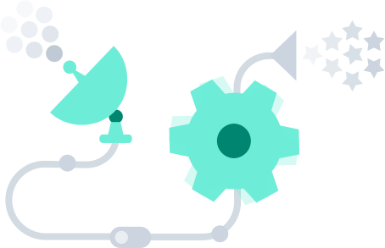
What triggers code execution?
Runs code in response to events
Event-programming model
Notes:
What is Serverless

Slide 29



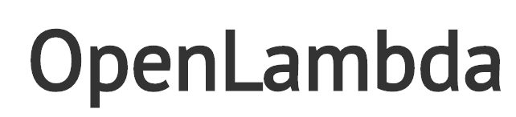


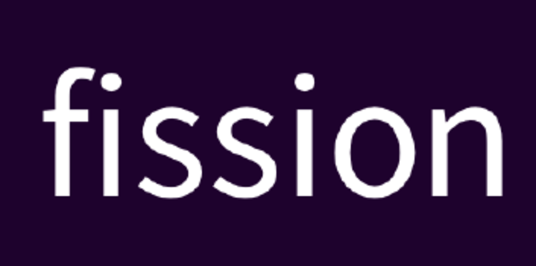
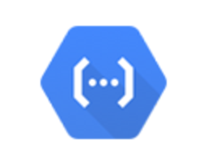



(Some) Current Platforms for Serverless
AWS Lambda
Azure Functions
Kubernetes
IBM Cloud Functions
Red-Hat
Google Functions
Notes:
Auth0, Twitter, ..
And many more upcoming / open source

Slide 30
Let’s Build a Lambda Function
We are going to do it manually to understand the process/steps.
There are several more complete approaches:
Pipelines
Serverless Framework (https://www.serverless.com/framework/docs/providers/aws/guide/intro)
AWS Toolkit for PyCharm (https://aws.amazon.com/pycharm/)
We will explore some of these ... ...

Slide 31
API Gateway
31 | E6156 – Topics in SW Engineering: Lecture 6: Middleware, APIGW, Lambda, SSO, Events © Donald F. Ferguson, 2021

Slide 32
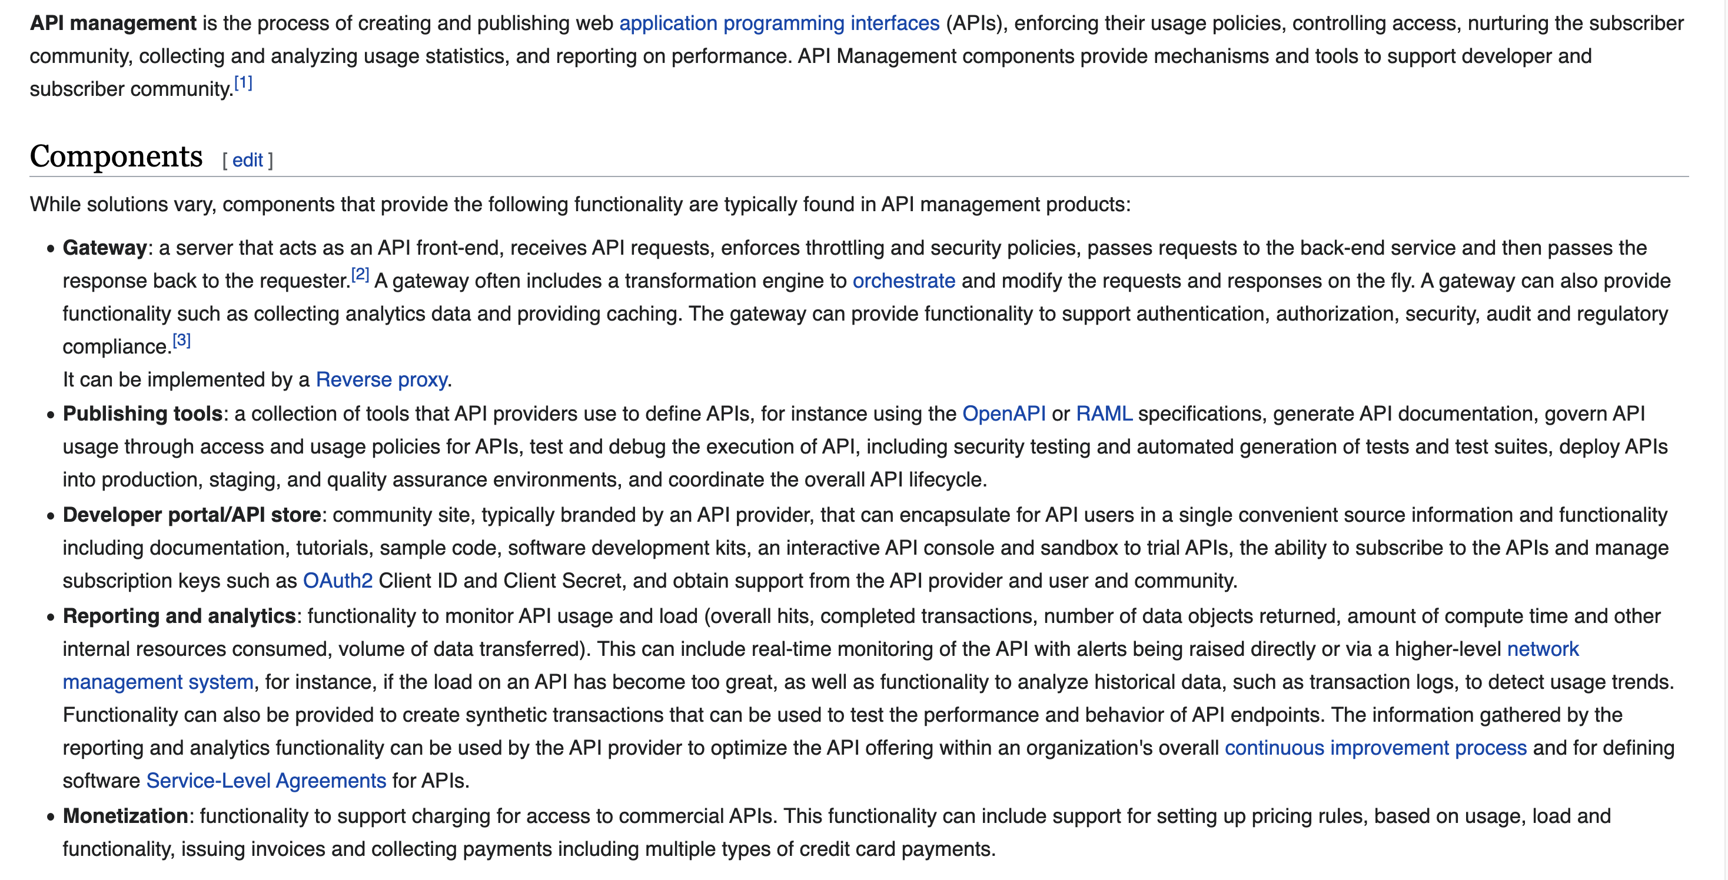
API Management

Slide 33
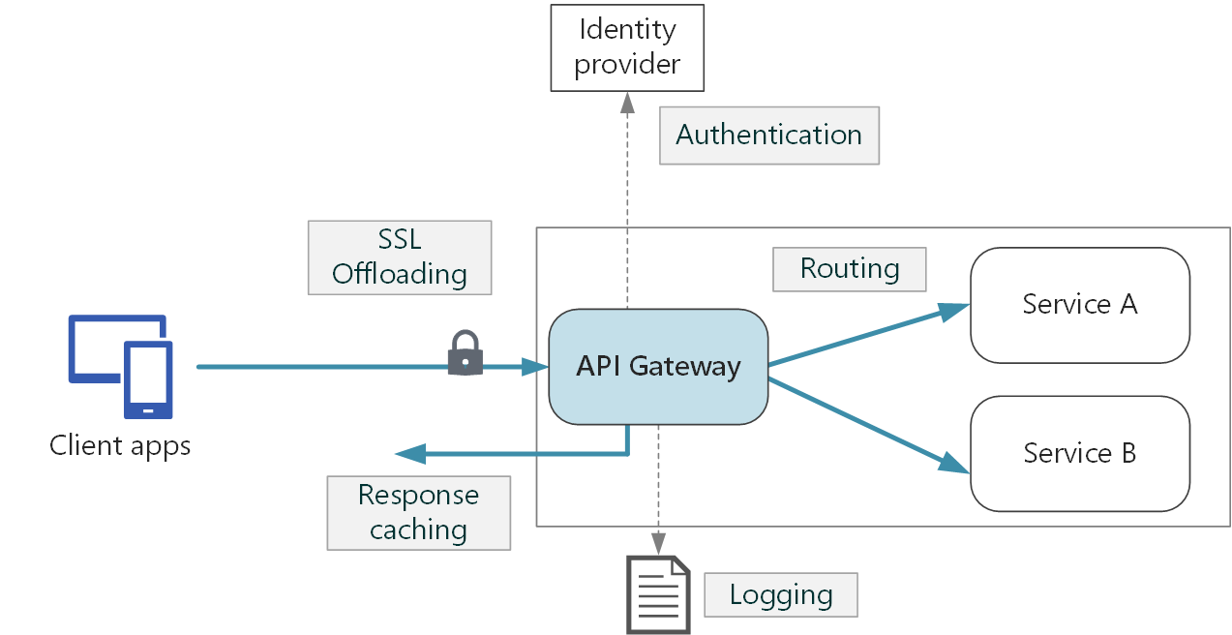
API Gateway (https://docs.microsoft.com/en-us/azure/architecture/microservices/design/gateway)
Some functions:
SSL termination
Authentication
IP allow/block list
Client rate limiting (throttling)
Logging and monitoring
Response caching
Web application firewall
GZIP compression
Servicing static content

Slide 34
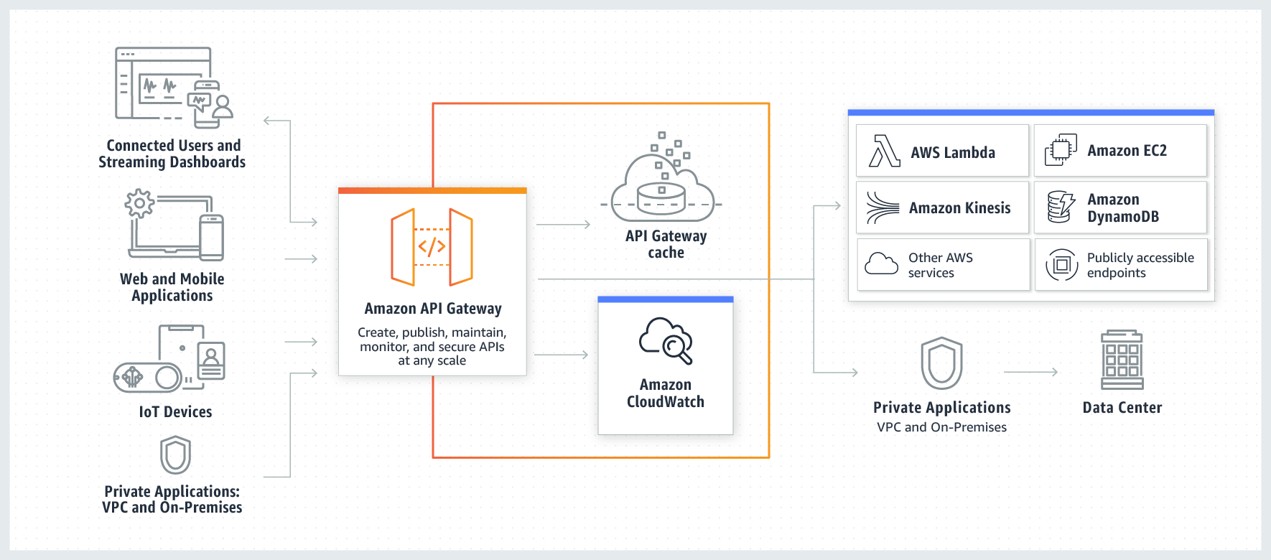
AWS API Gateway

Slide 35
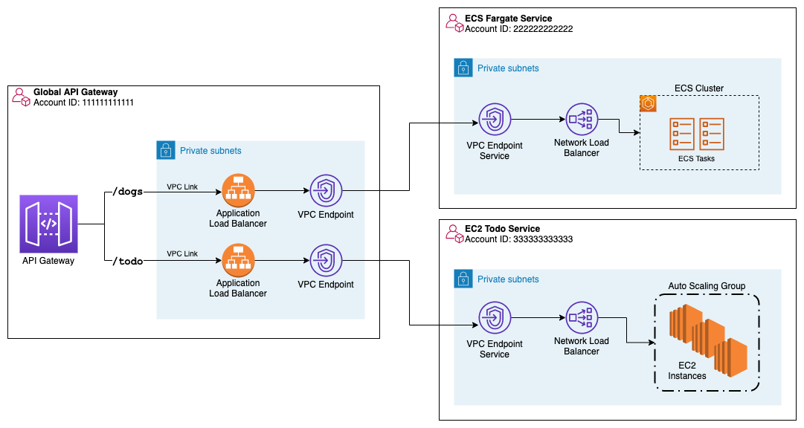
Initial Setup of an API Gateway
Show tests of API GW
Lambda function
HTTP to Elastic Beanstalk instance
API Key
Deploy and stages
API GW
Single point of entry.
Encapsulate things like EC2, Elastic Beanstalk, ... ...
Putting
Inside VPC
Behind ELB
Prevent access to the REST endpoint without going through API GW.
The configuration can get complex. We will not worry about it and keep ELB and EC2 endpoints “public.”

Slide 36
Motivating Scenario
36 | E6156 – Topics in SW Engineering: Lecture 6: Middleware, APIGW, Lambda, SSO, Events © Donald F. Ferguson, 2021

Slide 37
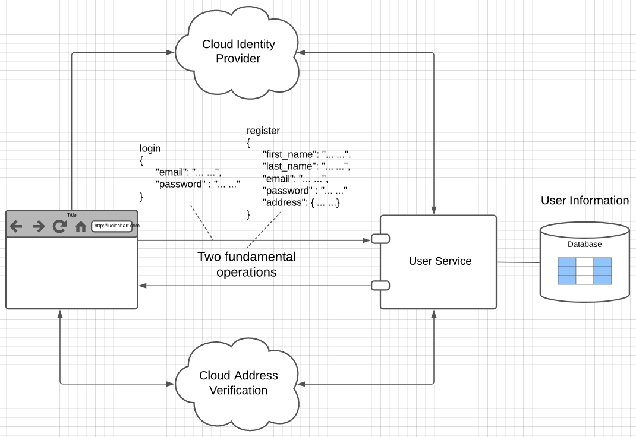
User Registration, Login and Profile
Two major challenges:
User management:
Securing the user/password database.
Implementing password reset.
Verifying email ownership to avoid spamming by registration.
Two factor
... ...
Addresses:
People are very bad at entering address information.
“620 w 120th St, NY NY”
”620 West 120th Street, NYC, NY”
Implementing these functions is tedious and non-core to your business. ➔ Use cloud services.

Slide 38
Cloud Identity (Open ID, OAuth2, ... ...) Reminder
38 | E6156 – Topics in SW Engineering: Lecture 6: Middleware, APIGW, Lambda, SSO, Events © Donald F. Ferguson, 2021

Slide 39
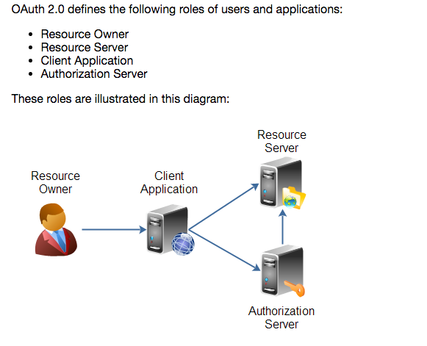
Overview (http://tutorials.jenkov.com/oauth2/index.html)
Resource Owner
Controls access to the “data.”
Facebook user, LinkedIn user, …
Resource Server
The website that holds/manages info.
Facebook, LinkedIn, ...
And provides access API.
Client Application
“The product you implemented.”
Wants to read/update
“On your behalf”
The data the data that the Resource Server maintains, e.g. posts, status, tweets, ...
Authorization Server
Grants/rejects authorization
Based on Resource Owner decisions.
Usually (logically) the same as Resource Server.

Slide 40
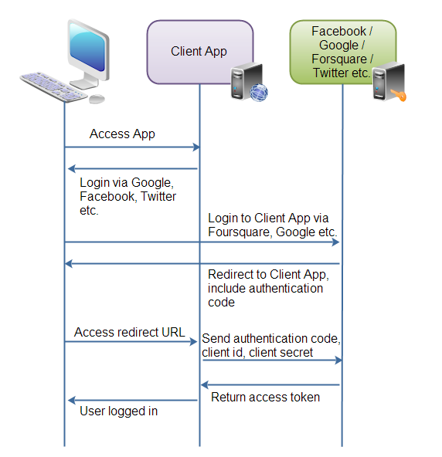
Roles/Flows
User Clicks “Logon with XXX”
Redirect user to XXX
With Client App application ID.
And permissions app requests.
Code MAY have to call Resource Server to get a token to include in redirect URL.
Browser redirected to XXX
Logon on to XXX prompt.
Followed by “do you grant permission to …”
Clicking button drives a redirect back to Client App. URL contains a temporary token.
User/Browser
Redirected to Client App URL with token.
Client App calls XXX API
Obtains access token.
Returns to User.
Client App can use access token on API calls.

Slide 41
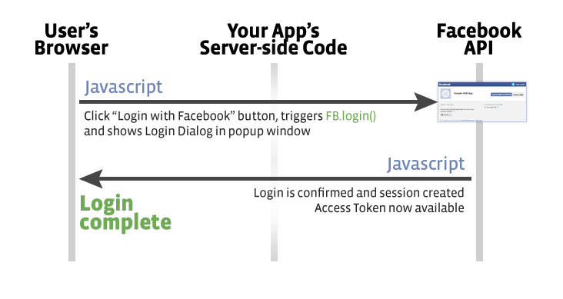
Facebook
Validate Token/Get Info
Register(Token)
OK
Save Data

Slide 42
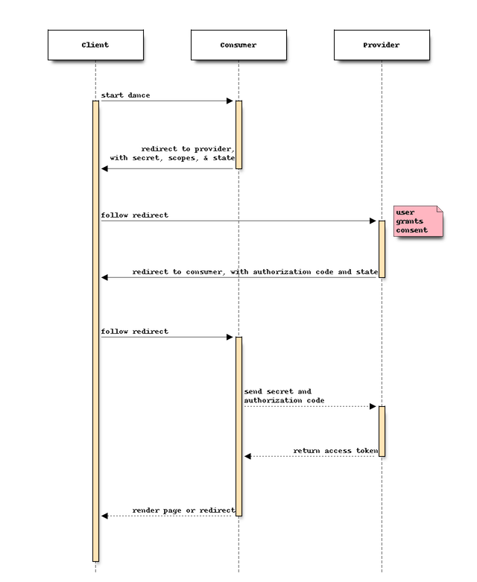
Walkthrough: Middleware and Security
Explain why I have to go incognito.
Show:
Project code ... ...
GCP application registration page.
Token in the header (Postman)
I normally do these things explicitly in my code.
I used Facebook in the past.
I decided to use Google because I expect people using my team management application to have Lionmail/Google accounts.
For expediency, I used Flask-Dance (https://flask-dance.readthedocs.io/en/latest/)
I understand the magic in general, but ...
I have not yet “learned the flask-dance magic” and how it uses the protocol under the hood.
The net is:
OAuth2 is about authorization, but ...
Getting the basic profile proves authentication
And, I can use to simplify the registration process.

Slide 43
HW2, Sprint 2
43 | E6156 – Topics in SW Engineering: Lecture 6: Middleware, APIGW, Lambda, SSO, Events © Donald F. Ferguson, 2021

Slide 44
HW2, Sprint 2

Slide 45
Backup
Backup

Slide 46
REST Method
When your handler receives a REST operation, there are the following elements. Not all methods have all elements:
Path
Path parameters
Query string parameters
Headers
Body
The REST handler’s response has the following elements:
Status code
Body
Headers
The route handler maps between the REST representation of the elements and the language/runtime representation.
Flask provides access through the
Request object.
Response object.
Walkthrough

Slide 47
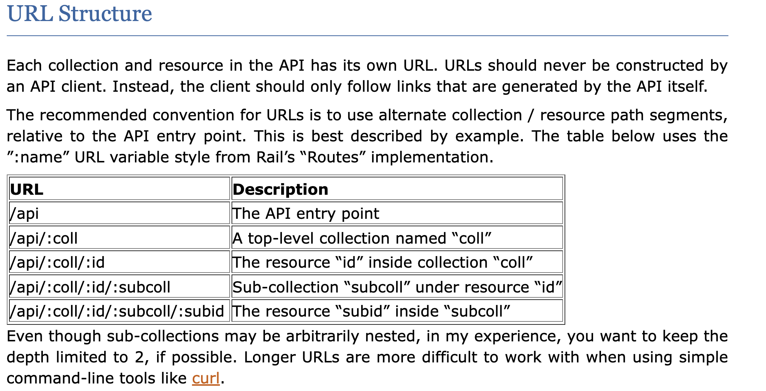
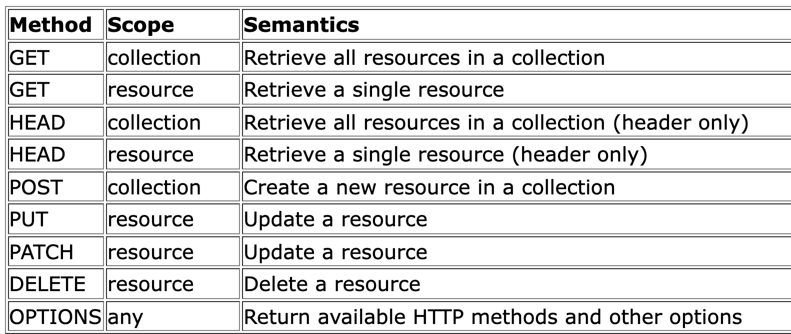
REST Paths
https://restful-api-design.readthedocs.io/en/latest/
There are many patterns. I typically follow something like:
We will not be too rigorous about status codes, but some common examples are:
200: OK (success)
201: CREATED (for POST)
404: NOT FOUND
500: INTERNAL SERVICE ERROR
418: I’M A TEAPOT

Slide 48
Success Response Codes
202 means
Your request went asynch.
The HTTP header Link is where to poll for rsp.
Operation | HTTP Request | HTTP Response Codes Supported
READ | GET | 200 - OK with message body 204 - OK no message body 206 - OK with partial message body
CREATE | POST | 201 - Resource created (Operation Complete) 202 - Resource accepted (Operation Pending)
UPDATE | PUT | 202 - Accepted (Operation Pending) 204 - Success (Operation Complete)
DELETE | DELETE | 202 - Accepted (Operation Pending) 204 - Success (Operation Complete)
Examples of Link Headers in HTTP response:
Link: <http://api/jobs/j1>;rel=monitor;title="update profile"
Link: <http://api/reports/r1>;rel=summary;title=”access report”

Slide 49
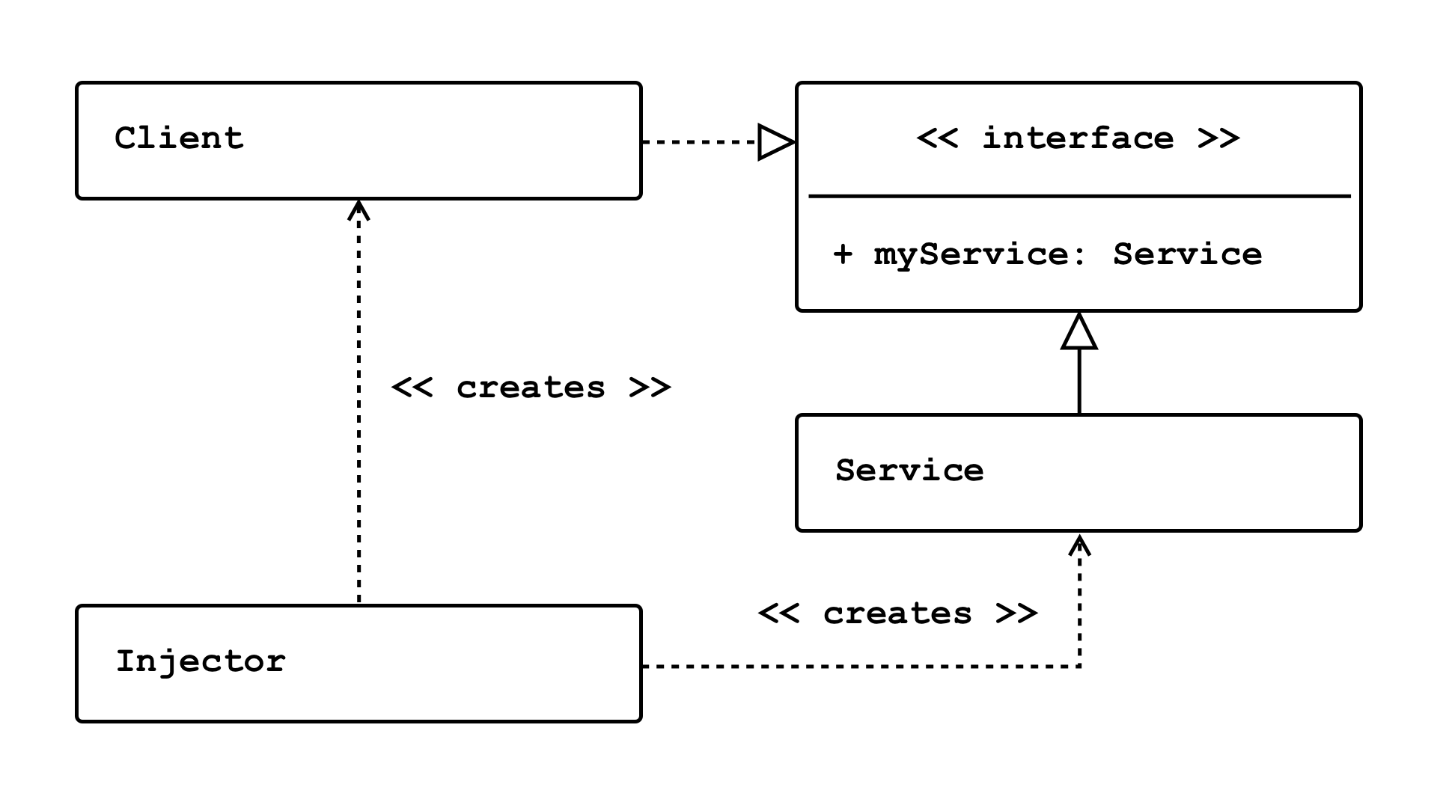
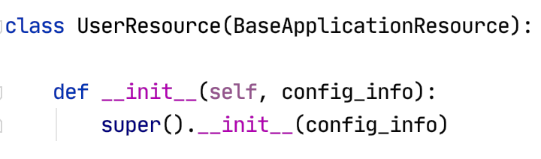
Dependency Injection
Concepts (https://en.wikipedia.org/wiki/Dependency_injection):
In software engineering, dependency injection is a technique in which an object receives other objects that it depends on, called dependencies.
The intent behind dependency injection is to achieve separation of concerns of construction and use of objects. This can increase readability and code reuse.
There is no single approach. There are several frameworks, tools, etc.
Like many other things, it is easy to get carried away and become dogmatic.
I follow a single approach:
A Context class converts environment and other configuration and provides to application.
The top-level application injects a config_info object into services.

Slide 50
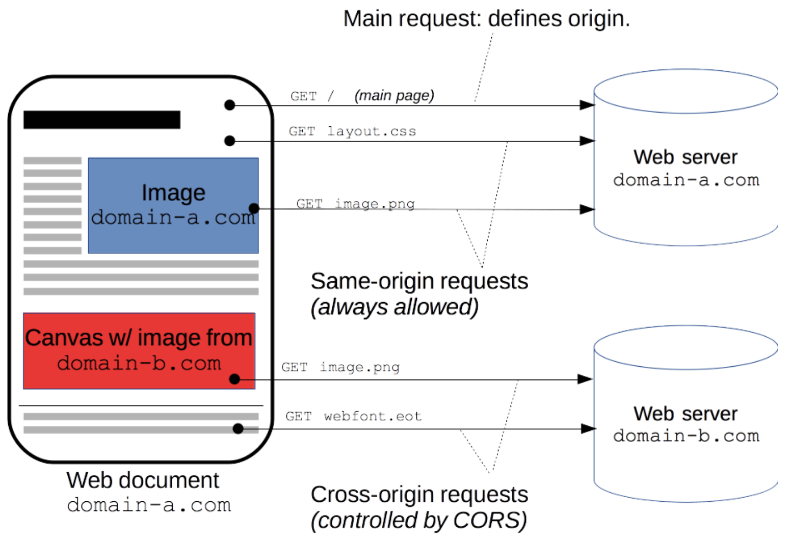
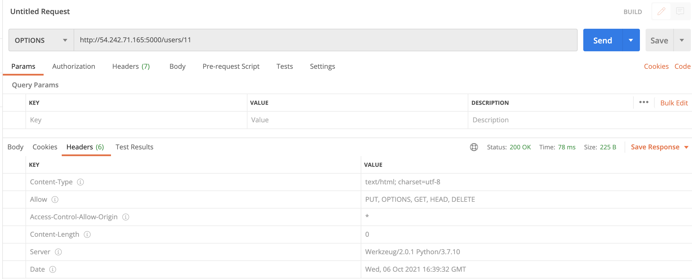
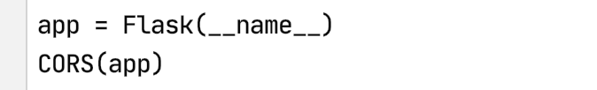
CORS
https://developer.mozilla.org/en-US/docs/Web/HTTP/CORS
“For security reasons, browsers restrict cross-origin HTTP requests initiated from scripts. For example, XMLHttpRequest and the Fetch API follow the same-origin policy. This means that a web application using those APIs can only request resources from the same origin the application was loaded from unless the response from other origins includes the right CORS headers.”

Slide 51
REST Principles HATEOAS
51 | E6156 – Topics in SW Engineering: Lecture 6: Middleware, APIGW, Lambda, SSO, Events © Donald F. Ferguson, 2021

Slide 52
REST Principles
REST Principles:
Uniform interface
Client–server
Stateless
Cacheable
Layered system
Code on demand (optional)
Many of these are straightforward. We will explore some of the concepts in various lectures.
Today, we cover “statelessness.”
HATEOAS: Hypertext as the Engine of Application State --
The principle is that a client interacts with a network application entirely through hypermedia provided dynamically by application servers. A REST client needs no prior knowledge about how to interact with any particular application or server beyond a generic understanding of hypermedia.

Slide 53
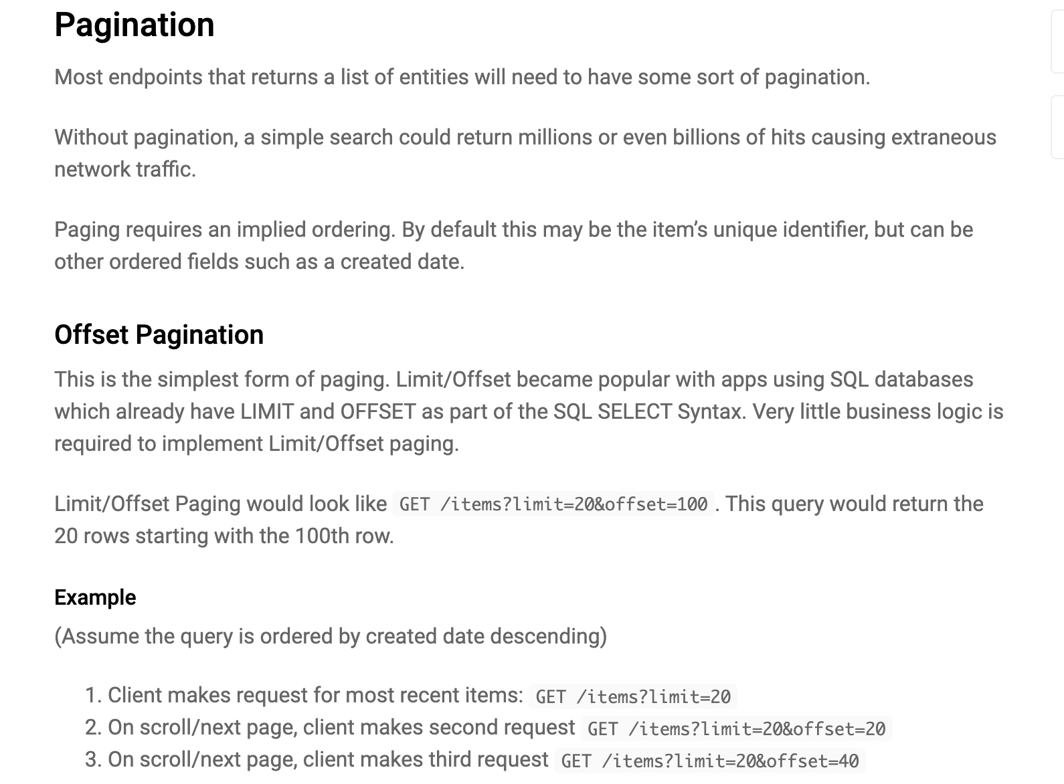
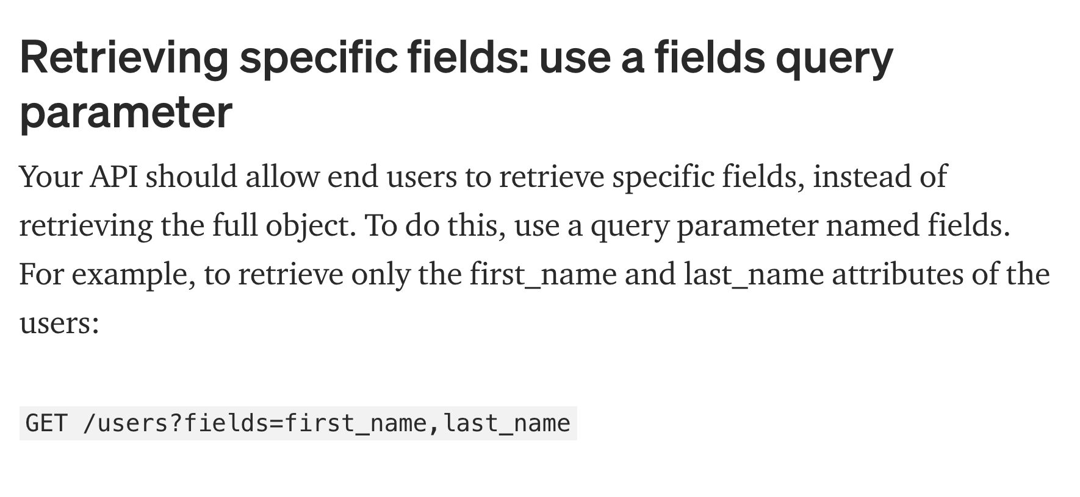
Pagination and Field Selection
https://www.moesif.com/blog/technical/api-design/REST-API-Design-Filtering-Sorting-and-Pagination/

